Slide 1
Data Engineering Day 2
Kerry Nakayama

Slide 2
Execution Plans

Slide 3

Objectives
Execution plans
Explain
Analyze plans
Older Systems
Seeks vs Scans
Nested loops/Hash/Merge Joins
Snowflake tools
Persisted Query results
Estimating Approximate values
Estimating HyperLogLog
Query Profile
Steps
How to access
Examples

Slide 4
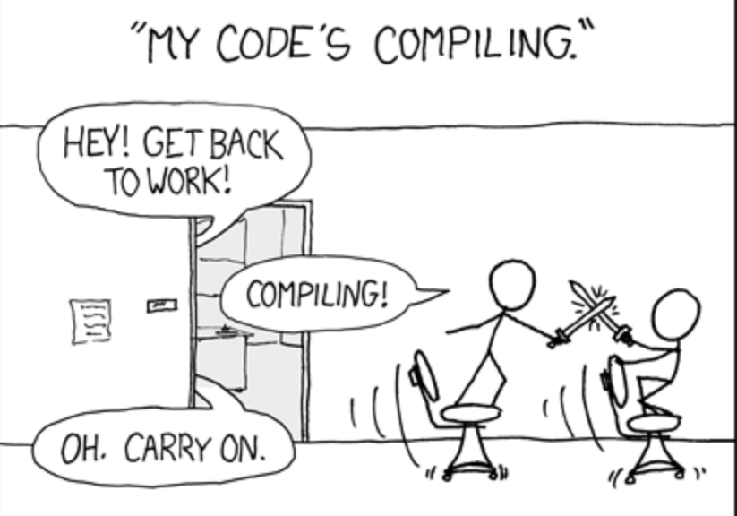
Execution Plans
Notes:
What my job has been at the last two companies – going into systems and optimizing them
But I haven’t always been that good at it….
Let me tell you the story of how I was forced to get better
Small publishing company
Took down the data warehouse not 1 time but 3 times in a matter of 2 hours. Ask my co-teacher about it he knows
So when they found out it was my code I was put on paid suspension for a week in which I had to focus on SQL (well that and watch movies since I wasn’t allowed to touch the DB)
I had to have all my queries and peer reviewed and submitted for them to run. They loved it. NOI
You know what gets you much better at your job.. Having everyone scrutinize over your work. If you ever want to get better at any coding do peer reviews on a regular basis.
And guys actually review the code. It doesn’t help anyone to approve code without reviewing it.
So back to this company – a week goes by and Netezza comes back with their head between their legs and let my boss know that it was actually their fault
They had a known bug that if you submitted a query with a union all, self join, and rank over windowing function that it would kill the system.
Yeah who knew I was doing pathing analysis on what category was the most likely to be read next based on the past three pages they just completed.
But long story short I really had to focus on my code and how it would run before I ran it largely since I wasn’t allowed to run anything for a week.
I got this image from a blog post about how snowflake has made this a thing of the past.
But we can’t just throw out execution plans bc Snowfalke’s architecture runs code lightning fast. Largely bc they may hire me to come in and slash costs
No Select *
Add limits
Do a preview data to understand what is in the table
Do an approximation of the aggregate function b4 running it on the entire table
Use query profile
Heck b4 that explain the query before it runs
We will focus today on these items

Slide 5

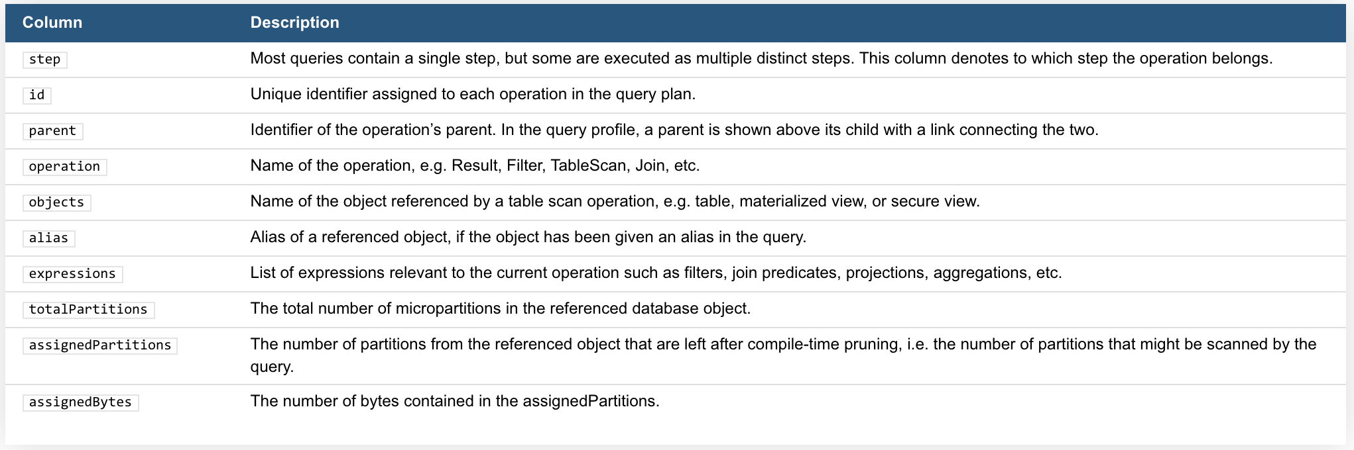
Explain
Returns the logical execution plan for the specified SQL statement.
EXPLAIN [ USING { TABULAR | JSON | TEXT } ] <statement>
Notes:
EXPLAIN compiles the SQL statement, but does not execute it, so EXPLAIN does not require a running warehouse.
Although EXPLAIN does not consume any compute credits, the compilation of the query does consume Cloud Service credits, just as other metadata operations do
The EXPLAIN plan is the “logical” explain plan. It shows the operations that will be performed, and their logical relationship to each other. The actual execution order of the operations in the plan does not necessarily match the logical order shown by the plan
Based on a change made February 2020 snowflake …
A significant amount of cloud services resources, measured as up to 10% of consumed daily virtual warehouse compute, will continue to be provided for free. However, we will start charging for cloud services usage above the 10% daily threshold – running this before you run your query should not affect the billing but good to monitor the usage

Slide 6
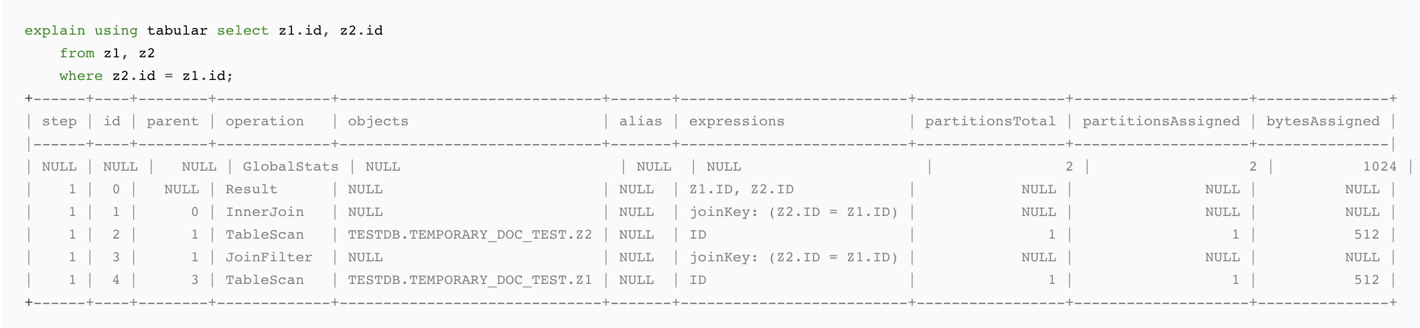
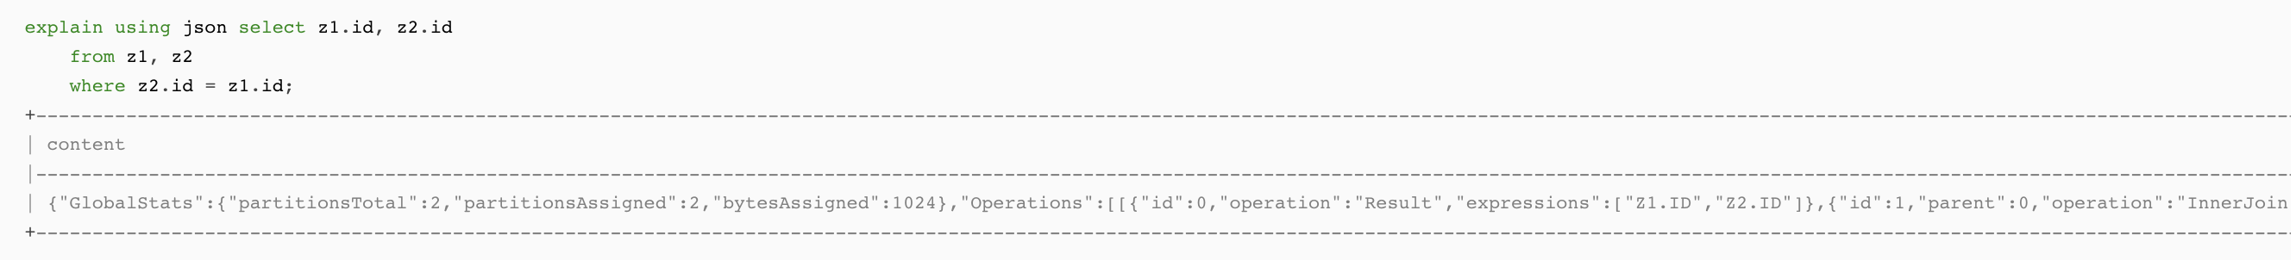
Explain
Notes:
DEMO
Column
Description
step
Most queries contain a single step, but some are executed as multiple distinct steps. This column denotes to which step the operation belongs.
id
Unique identifier assigned to each operation in the query plan.
parent
Identifier of the operation’s parent. In the query profile, a parent is shown above its child with a link connecting the two.
operation
Name of the operation, e.g. Result, Filter, TableScan, Join, etc.
objects
Name of the object referenced by a table scan operation, e.g. table, materialized view, or secure view.
alias
Alias of a referenced object, if the object has been given an alias in the query.
expressions
List of expressions relevant to the current operation such as filters, join predicates, projections, aggregations, etc.
totalPartitions
The total number of micropartitions in the referenced database object.
assignedPartitions
The number of partitions from the referenced object that are left after compile-time pruning, i.e. the number of partitions that might be scanned by the query.
assignedBytes
The number of bytes contained in the assignedPartitions.

Slide 7
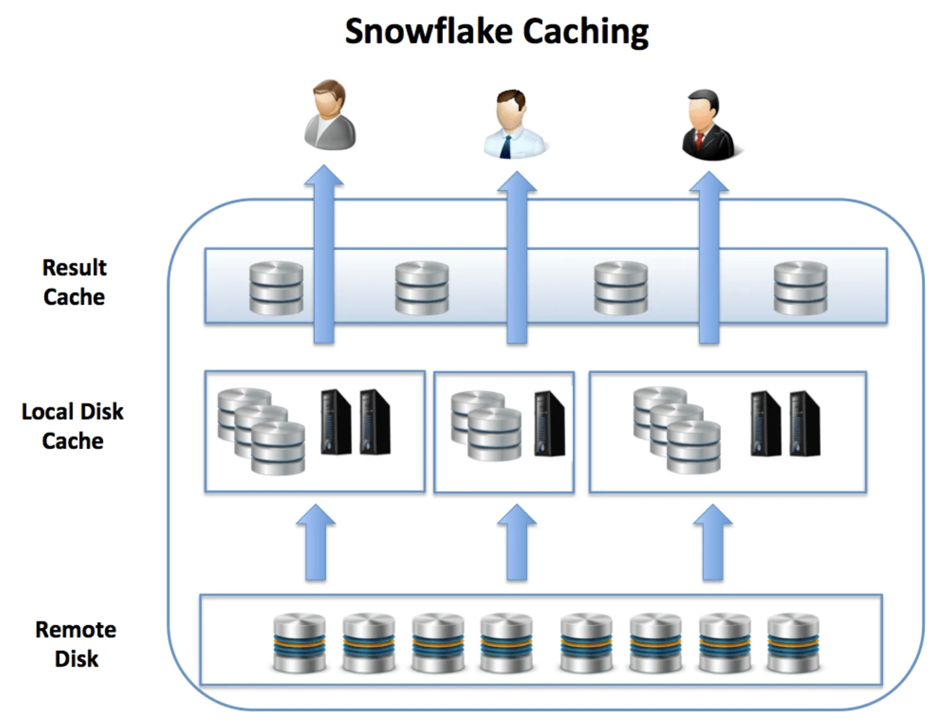
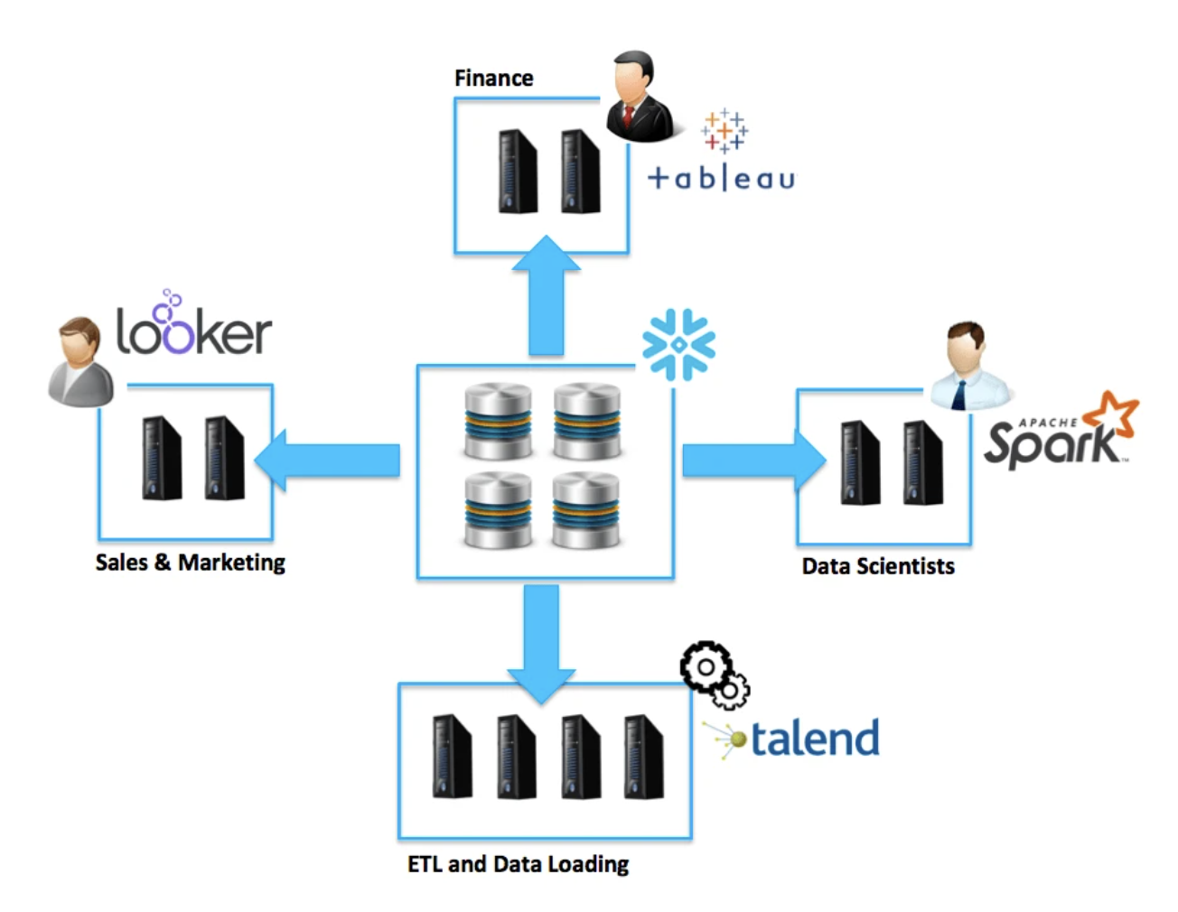
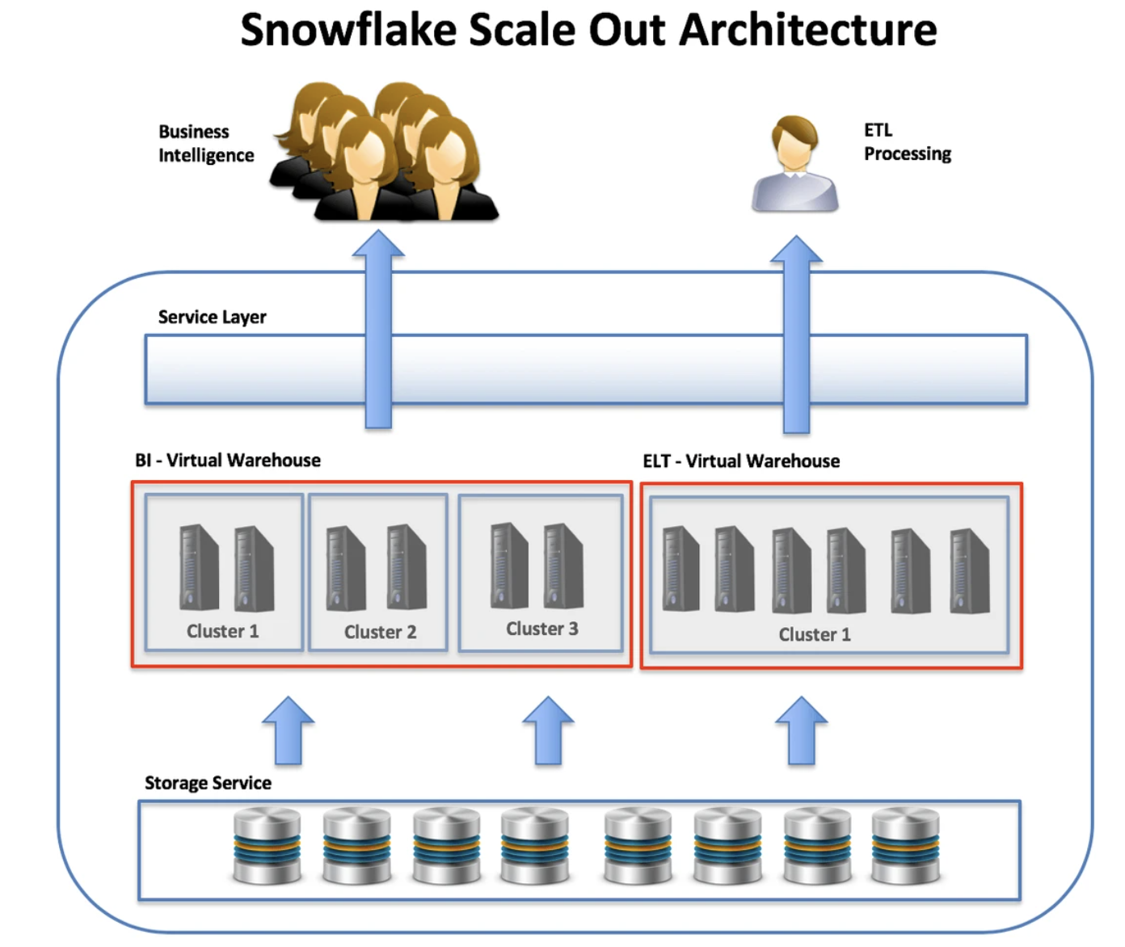
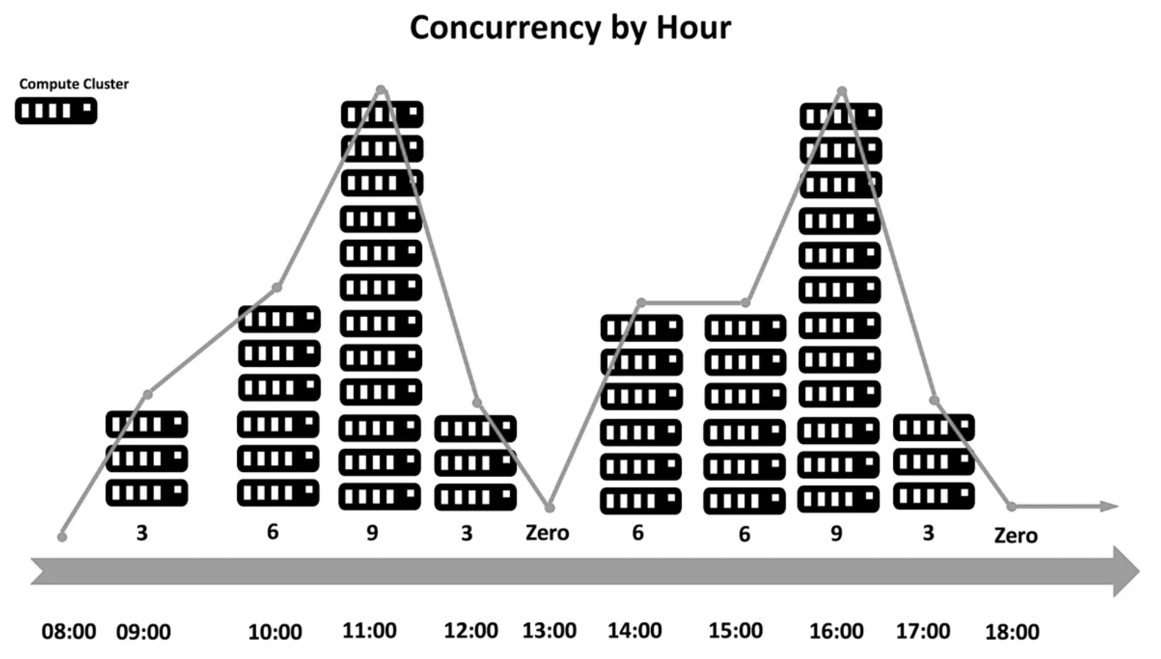
Analyze Plans
Optimizing the plan is more than just checking the queries now days
Maximize your cache
Separate Query Workloads
Scale up for large workloads
Scale horizontally for concurrency
Notes:
Snowflake automatically caches data in the Virtual Warehouse (the local disk cache) and in the Result Cache.
Firstly, when segmenting query workload you should place users querying the same data on the same virtual warehouse. This maximizes the chances that data retrieved to the cache by one user will also be used by others.
Don’t jump to conclusions about the auto suspend feature. You can actually save money by not suspending your virtual warehouse and saving the cache during work hours
Finally, be aware that the result cache is completely independent of virtual warehouse, and any query executed by any user on the account will be served from the result cache, provided the SQL text is exactly the same
Separate query workloads
Most companies will create VWH for each team so they can monitor the usage. And this may be a good plan when you are building/ designing the system.
Btu think about what each person or team is running and group like teams together
Don’t put finance with marketing if they are only running quick queries to update a dashboard. Match them with the product manager who cached their dashboards when they first got in.
Scale up for large work loads
In virtual warehouses, local storage is always fast SSD, but any large sort operations which are unable to complete in memory will inevitably spill to local storage. If, however, you see a large amount of data spilled to external storage, this indicates even the SSD storage has been used up, and data is being written to S3 or Blob storage which is much slower. Both of these are clear indicators you should consider adjusting to a larger virtual warehouse which has both more memory and local SSD storage.
As the number of concurrent users varies during the day, the clusters are automatically suspended, so you are only charged for the compute resources you actually need. The diagram below illustrates how this happens, with additional clusters automatically added up to the user selected limit, and automatically suspended when not needed.

Slide 8
Seeks vs Scans
Index Scan: Since a scan touches every row in the table, whether or not it qualifies, the cost is proportional to the total number of rows in the table. Thus, a scan is an efficient strategy if the table is small or if most of the rows qualify for the predicate.
Index Seek: Since a seek only touches rows that qualify and pages that contain these qualifying rows, the cost is proportional to the number of qualifying rows and pages rather than to the total number of rows in the table.
Notes:
Snowflake eliminates this with micro partitions and organization of the data and order. When you are using a DWH that you have to set up the indexing efficiently think through this

Slide 9
Nested Loop vs Hash vs Merge joins
index nested loops join when the search can utilize an existing index to perform lookups
temporary index nested loops join if the optimizer creates a temporary index as part of the query plan and destroys it after query execution completes.
Merge Join – both inputs need to be sorted on the join keys/merge columns or have clustered indexes
Hash Join - used with large input tables and no adequate indexes exist on them. Two phases are needed : build input and probe the input

Slide 10
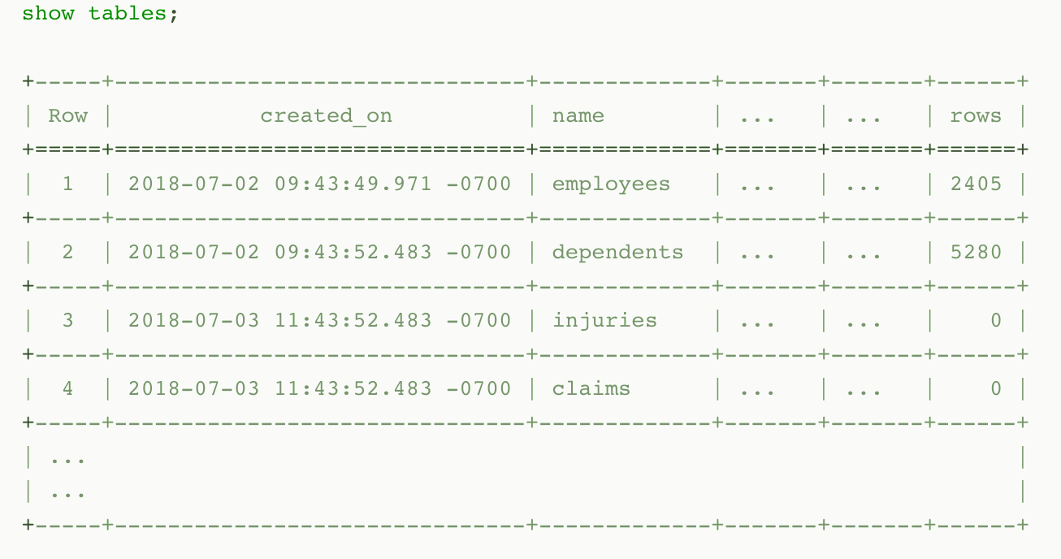
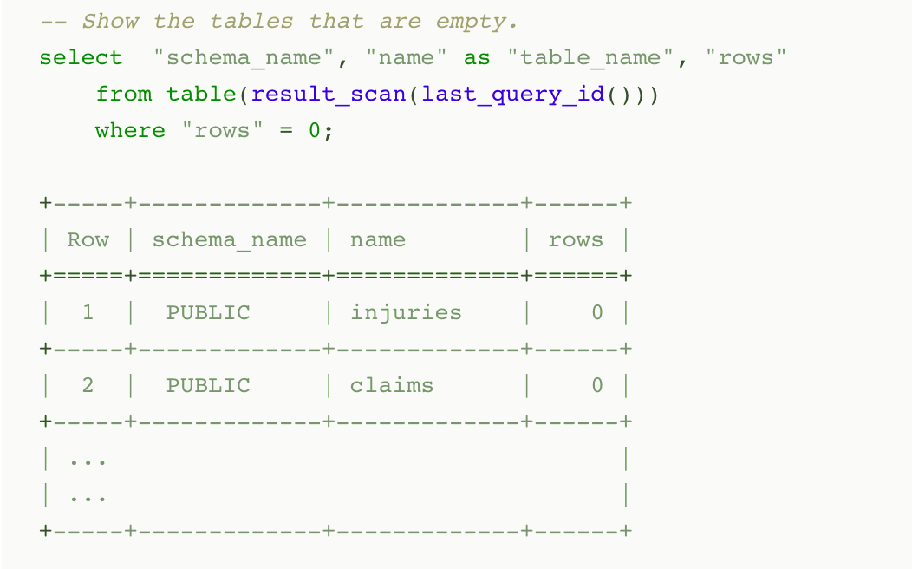
Persisted Query Results
When a query is executed, the result is persisted (i.e. cached) for a period (currently 24 hours). At the end of the time period, the result is purged from the system
Snowflake uses persisted query results to avoid re-generating results when nothing has changed
you can perform further processing on the result of a query that you’ve already run
Notes:
Typically, query results are reused if all of the following conditions are met:
The new query syntactically matches the previously-executed query.
The table data contributing to the query result has not changed.
The persisted result for the previous query is still available.
The role accessing the cached results has the required privileges If the query was a SELECT query, the role executing the query must have the necessary access privileges for all the tables used in the cached query.If the query was a SHOW query, the role executing the query must match the role that generated the cached results.
Any configuration options that affect how the result was produced have not changed.
The query does not include functions that must be evaluated at execution time, e.g. CURRENT_TIMESTAMP and UUID_STRING. (Note that the the CURRENT_DATE() function is an exception to this rule; even though CURRENT_DATE() is evaluated at execution time, queries that use CURRENT_DATE() can still use the query reuse feature.)
The table’s micro-partitions have not changed (e.g. been reclustered or consolidated) due to changes to other data in the table.

Slide 11
Estimating Approximate Values
Estimating Values
Snowflake uses the Space-Saving algorithm, a space and time efficient way of estimating approximate frequent values in data sets
Snowflake uses the t-Digest algorithm, a space and time efficient way of estimating approximate percentile values in data sets.
Notes:
DEMO

Slide 12
Estimating with HyperLogLog (HLL)
HyperLogLog is used to estimate the approximate number of distinct values in a data set
HLL can be used in place of COUNT(DISTINCT …) in situations where estimating cardinality is acceptable
HLL Returns an approximate distinct cardinality of the input
HLL_ACCUMULATE Skips the final estimation step and returns the HLL state at the end of an aggregation.
HLL_COMBINE Combines (i.e. merges) input states into a single output state
HLL_ESTIMATE Computes a cardinality estimate of a HLL state produced by HLL_ACCUMULATE and HLL_COMBINE
HLL_EXPORT Converts HLL states from BINARY format to an OBJECT (which can then be printed and exported as JSON).
HLL_IMPORT Converts HLL states from OBJECT format to BINARY format
Notes:
HyperLogLog implementation is 1.62338% (i.e. the average relative difference to the corresponding COUNT(DISTINCT …)
DEMO

Slide 13

Query Profile to Analyze Queries
Query Profile
QP is a powerful tool for understanding the mechanics of queries
It can be used whenever you want or need to know more about the performance or behavior of a particular query
It is designed to help you spot typical mistakes in SQL query expressions to identify potential performance bottlenecks and improvement opportunities
Data Processing Operators
Filter
Join
Aggregate
Grouping Sets
Window Function
Sort / Sort with Limit
Flatten
Join Filter
Union All
Data Access and Generation Operators
Table Scan
Values Clause
Generator
External Scan
Internal Object
DML Operators
Insert
Delete
Update
Merge
Unload
Notes:
TableScan Represents access to a single table. Attributes:
Full table name — the name of the accessed table, including database and schema.
Columns — list of scanned columns
Table alias — used table alias, if present
Extracted Variant paths — list of paths extracted from VARIANT columns
ValuesClause List of values provided with the VALUES clause. Attributes:
Number of values — the number of produced values.
Values — the list of produced values.
Generator Generates records using the TABLE(GENERATOR(...)) construct. Attributes:
rowCount — provided rowCount parameter.
timeLimit — provided timeLimit parameter.
ExternalScan Represents access to data stored in stage objects. Can be a part of queries that scan data from stages directly, but also for data-loading COPY queries. Attributes:
Stage name — the name of the stage where the data is read from.
Stage type — the type of the stage (e.g. TABLE STAGE).
InternalObject Represents access to an internal data object (e.g. an Information Schema table or the result of a previous query). Attributes:
Object Name — the name or type of the accessed object.
Data Processing Operators
Filter Represents an operation that filters the records. Attributes:
Filter condition - the condition used to perform filtering.
Join Combines two inputs on a given condition. Attributes:
Join Type — Type of join (e.g. INNER, LEFT OUTER, etc.).
Equality Join Condition — for joins which use equality-based conditions, it lists the expressions used for joining elements.
Additional Join Condition — some joins use conditions containing non-equality based predicates. They are listed here.
Aggregate Groups input and computes aggregate functions. Can represent SQL constructs such as GROUP BY, as well as SELECT DISTINCT. Attributes:
Grouping Keys — if GROUP BY is used, this lists the expressions we group by.
Aggregate Functions — list of functions computed for each aggregate group, e.g. SUM.
GroupingSets Represents constructs such as GROUPING SETS, ROLLUP and CUBE. Attributes:
Grouping Key Sets — list of grouping sets
Aggregate Functions — list of functions computed for each group, e.g. SUM.
WindowFunction Computes window functions. Attributes:
Window Functions — list of window functions computed.
Sort Orders input on a given expression. Attributes:
Sort keys — expression defining the sorting order.
SortWithLimit Produces a part of the input sequence after sorting, typically a result of an ORDER BY ... LIMIT ... OFFSET ... construct in SQL. Attributes:
Sort keys — expression defining the sorting order.
Number of rows — number of rows produced.
Offset — position in the ordered sequence from which produced tuples are emitted.
Flatten Processes VARIANT records, possibly flattening them on a specified path. Attributes:
input — the input expression used to flatten the data.
JoinFilter Special filtering operation that removes tuples that can be identified as not possibly matching the condition of a Join further in the query plan. Attributes:
Original join ID — the join used to identify tuples that can be filtered out.
UnionAll Concatenates two inputs. Attributes: none.
DML Operators
Insert Adds records to a table either through an INSERT or COPY operation. Attributes:
Input expressions — which expressions are inserted.
Table names — names of tables that records are added to.
Delete Removes records from a table. Attributes:
Table name — the name of the table that records are deleted from.
Update Updates records in a table. Attributes:
Table name — the name of the updated table.
Merge Performs a MERGE operation on a table. Attributes:
Full table name — the name of the updated table.
Unload Represents a COPY operation that exports data from a table into a file in a stage. Attributes:
Location - the name of the stage where the data is saved.

Slide 14
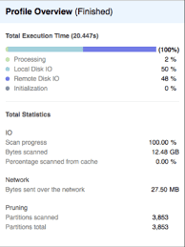
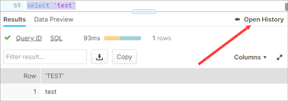
Query Profile
Powerful tool for understanding the mechanics of queries
Identify potential performance bottlenecks
Available through the web interface
Provides a graphical representation of the main components of processing plan for the query
Provides statistics and details of the overall query
Notes:
We will circle back to this later today but good to take a look at it now

Slide 15
Query Profile

Slide 16

Confused? ASK QUESTIONS

Slide 17
Break & Lab3
Notes:
Maybe the concurrency and caching lab (or optimize a query)

